Slide 1


Slide 2
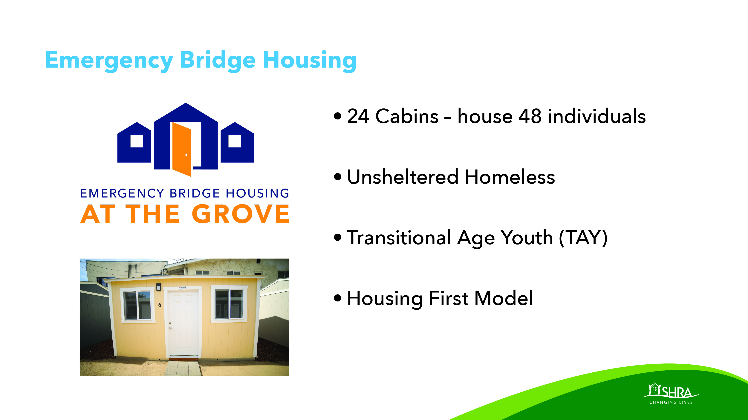

Slide 3
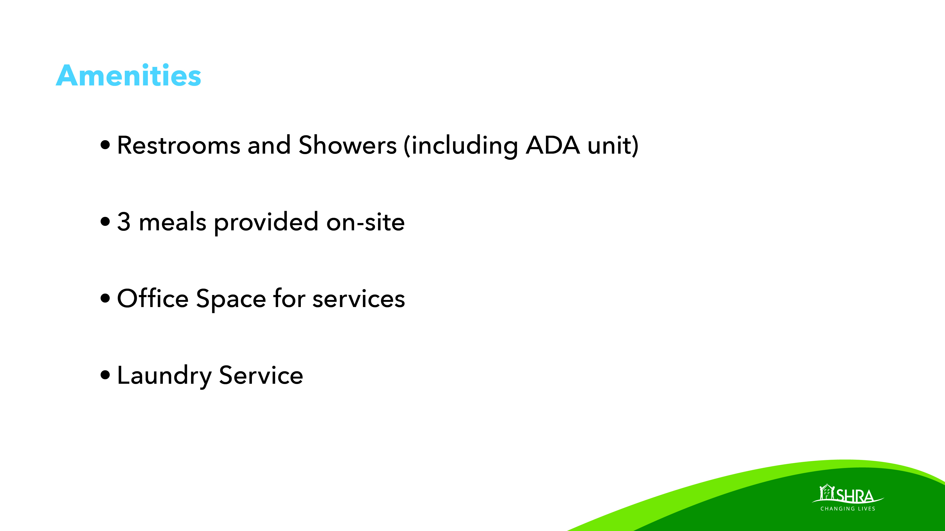
Notes:
Food Bank donation site

Slide 4
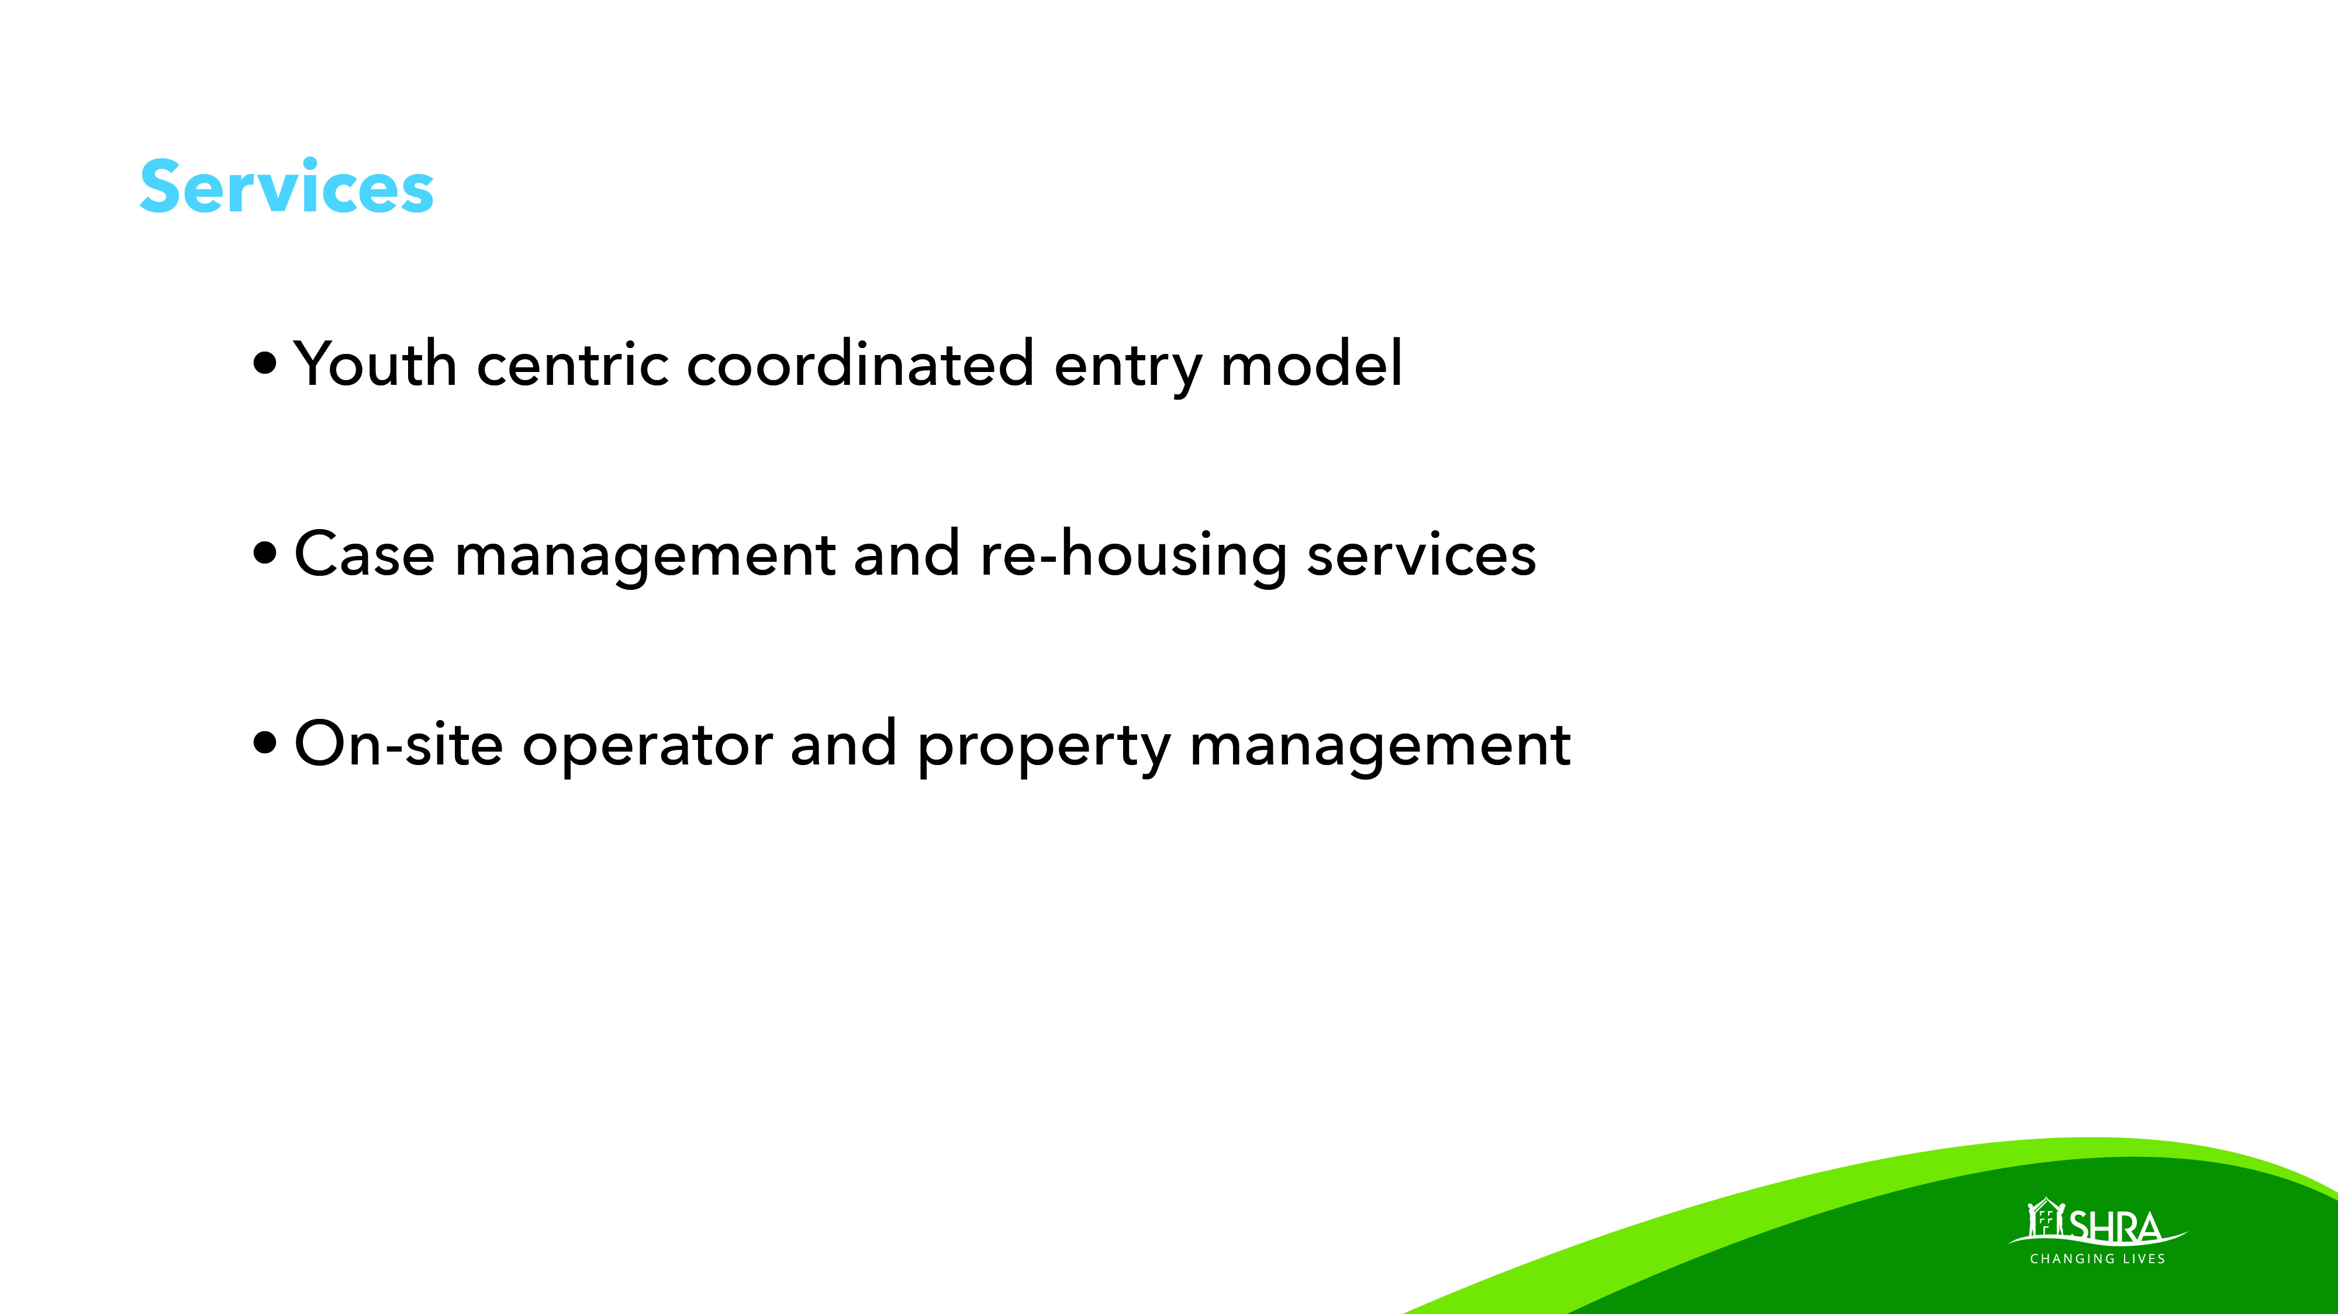

Slide 5
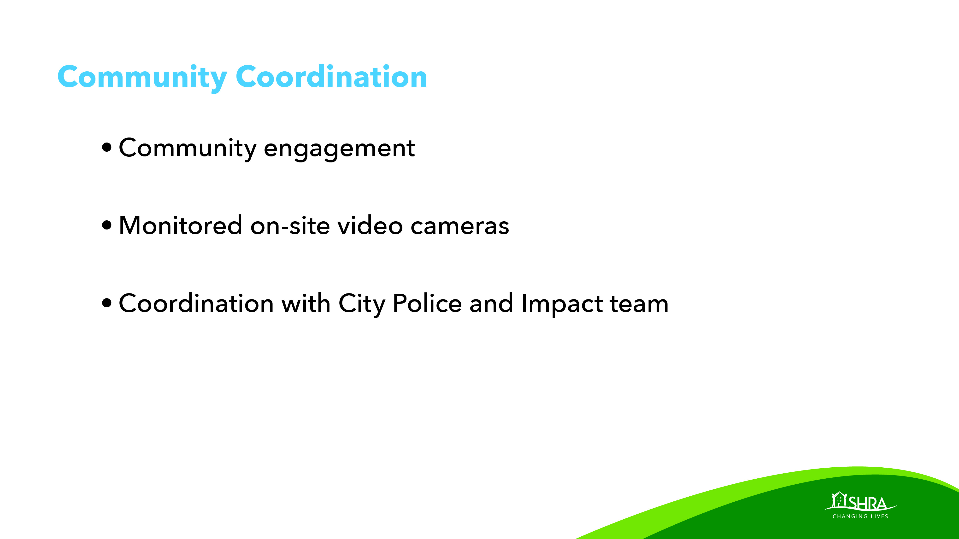

Slide 6
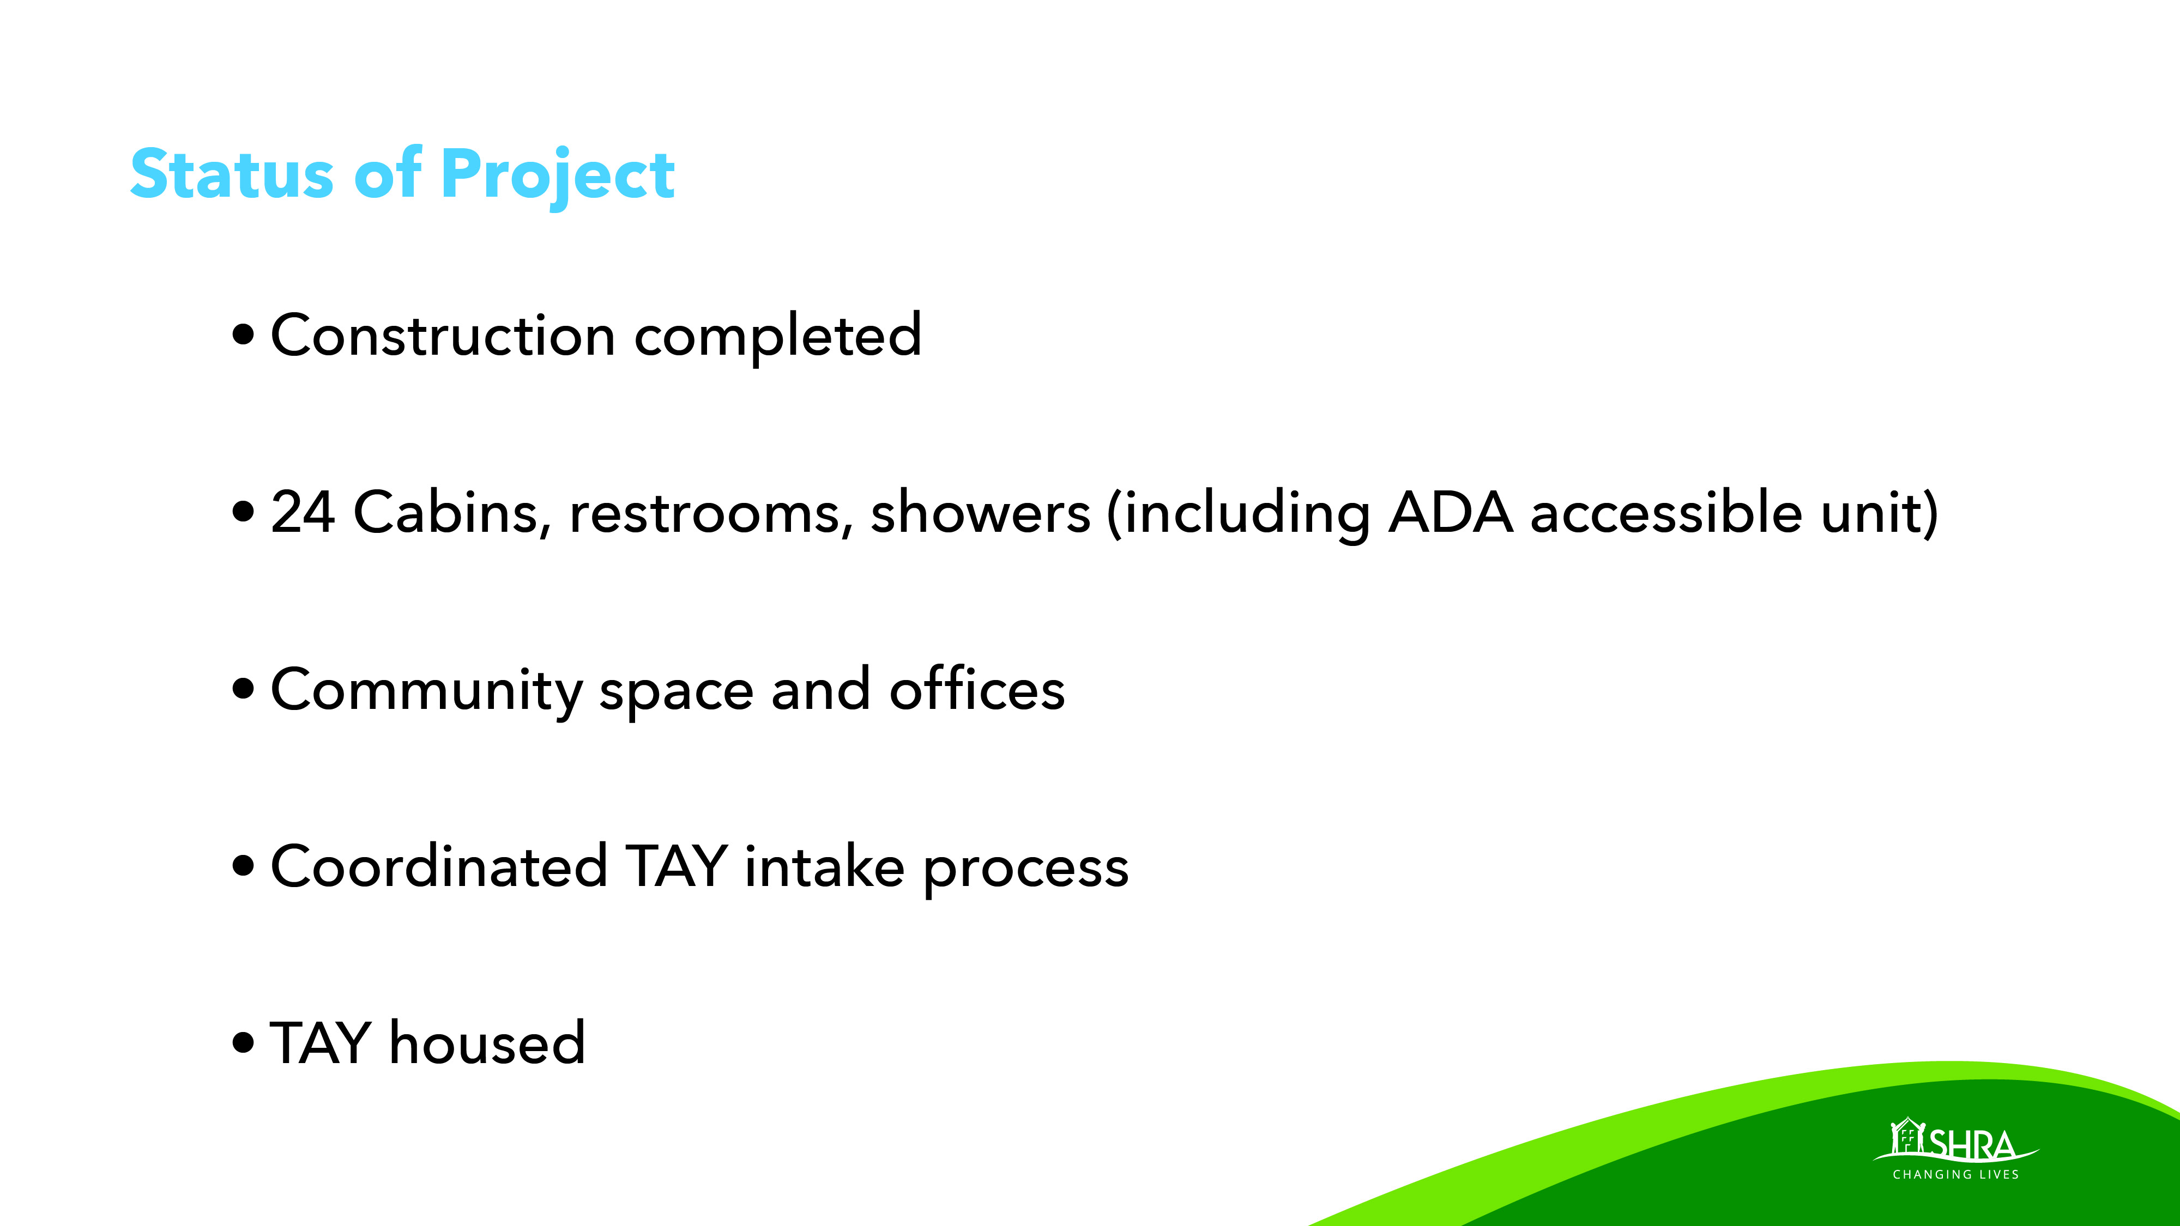

Slide 7
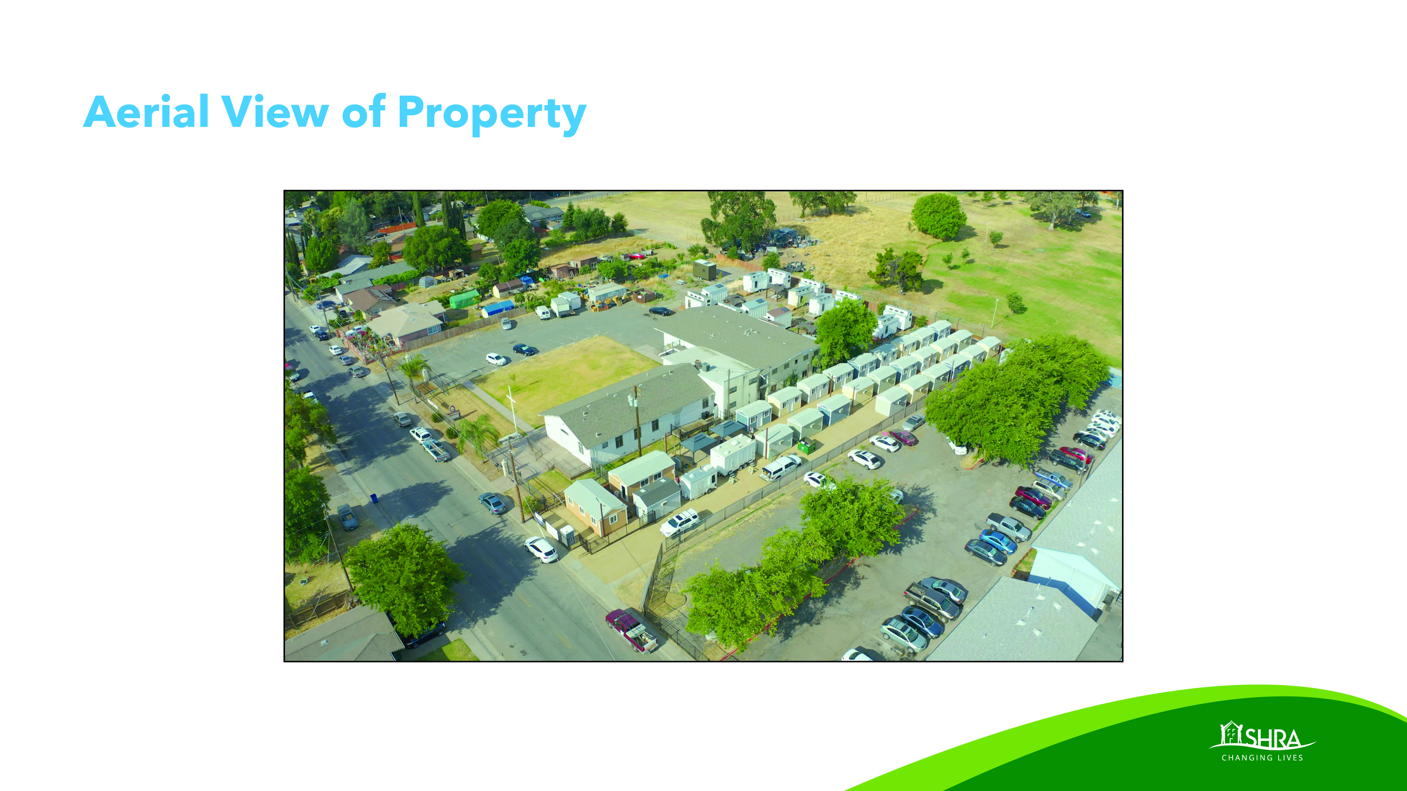

Slide 8
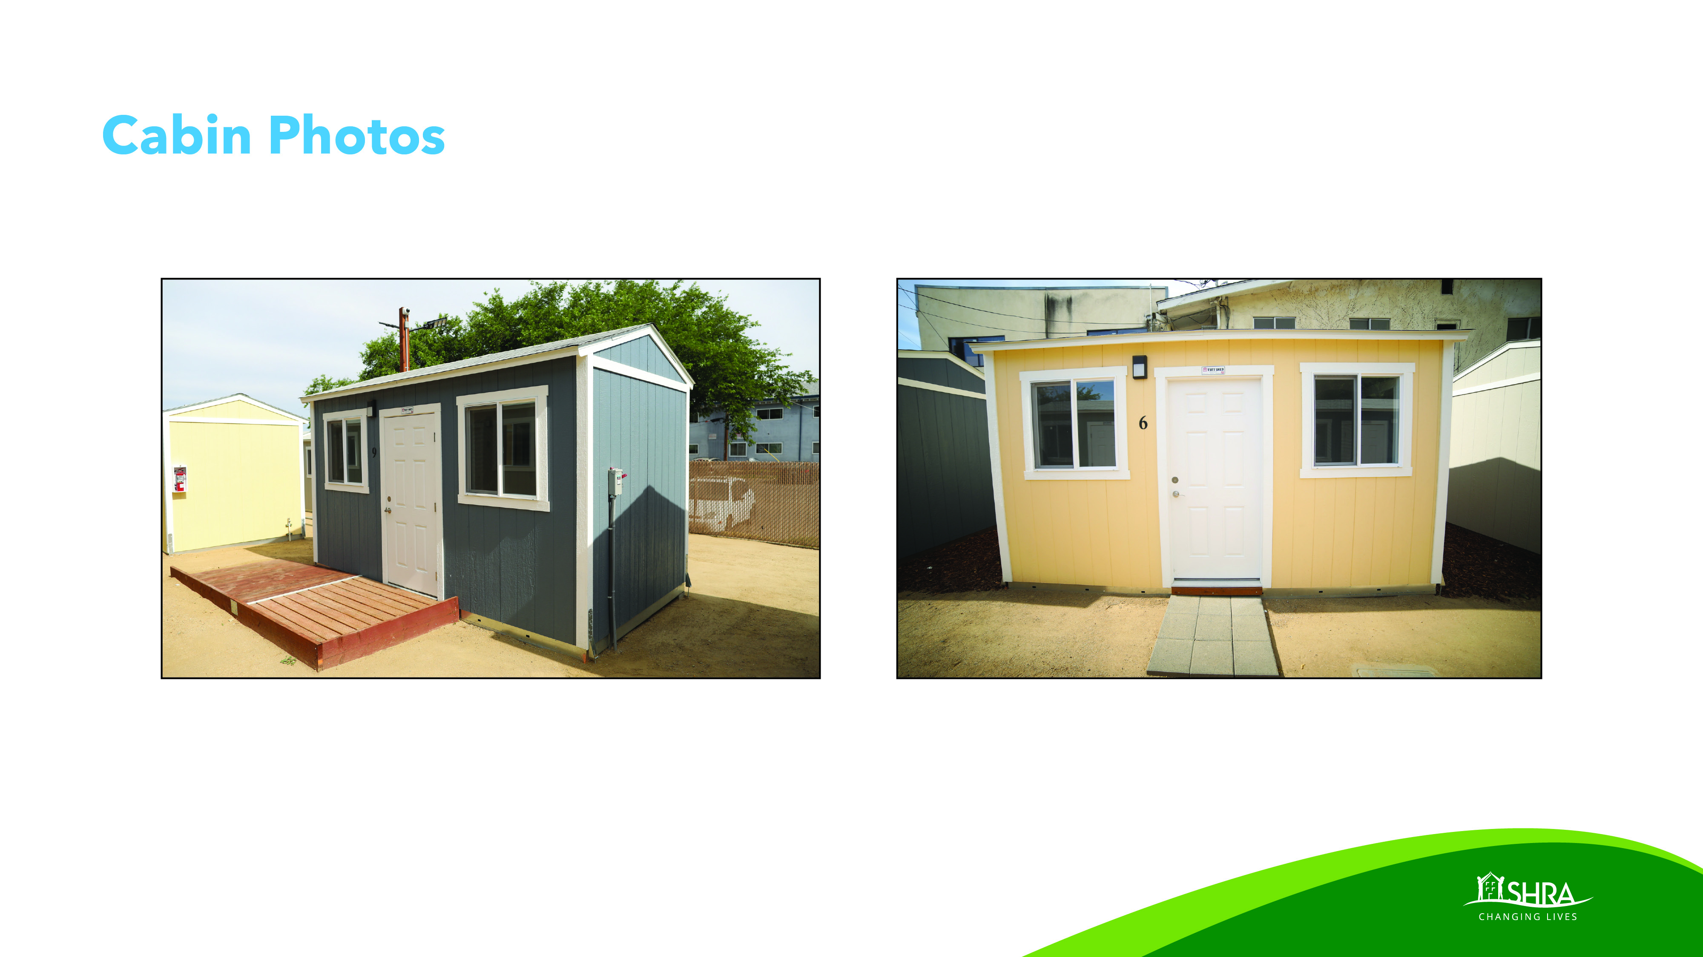

Slide 9


Slide 10
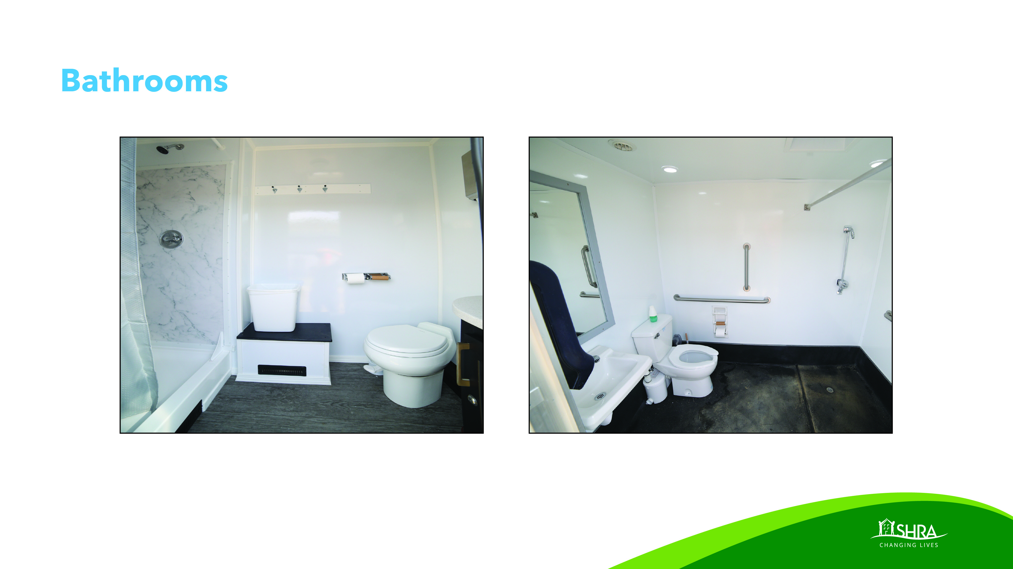

Slide 11
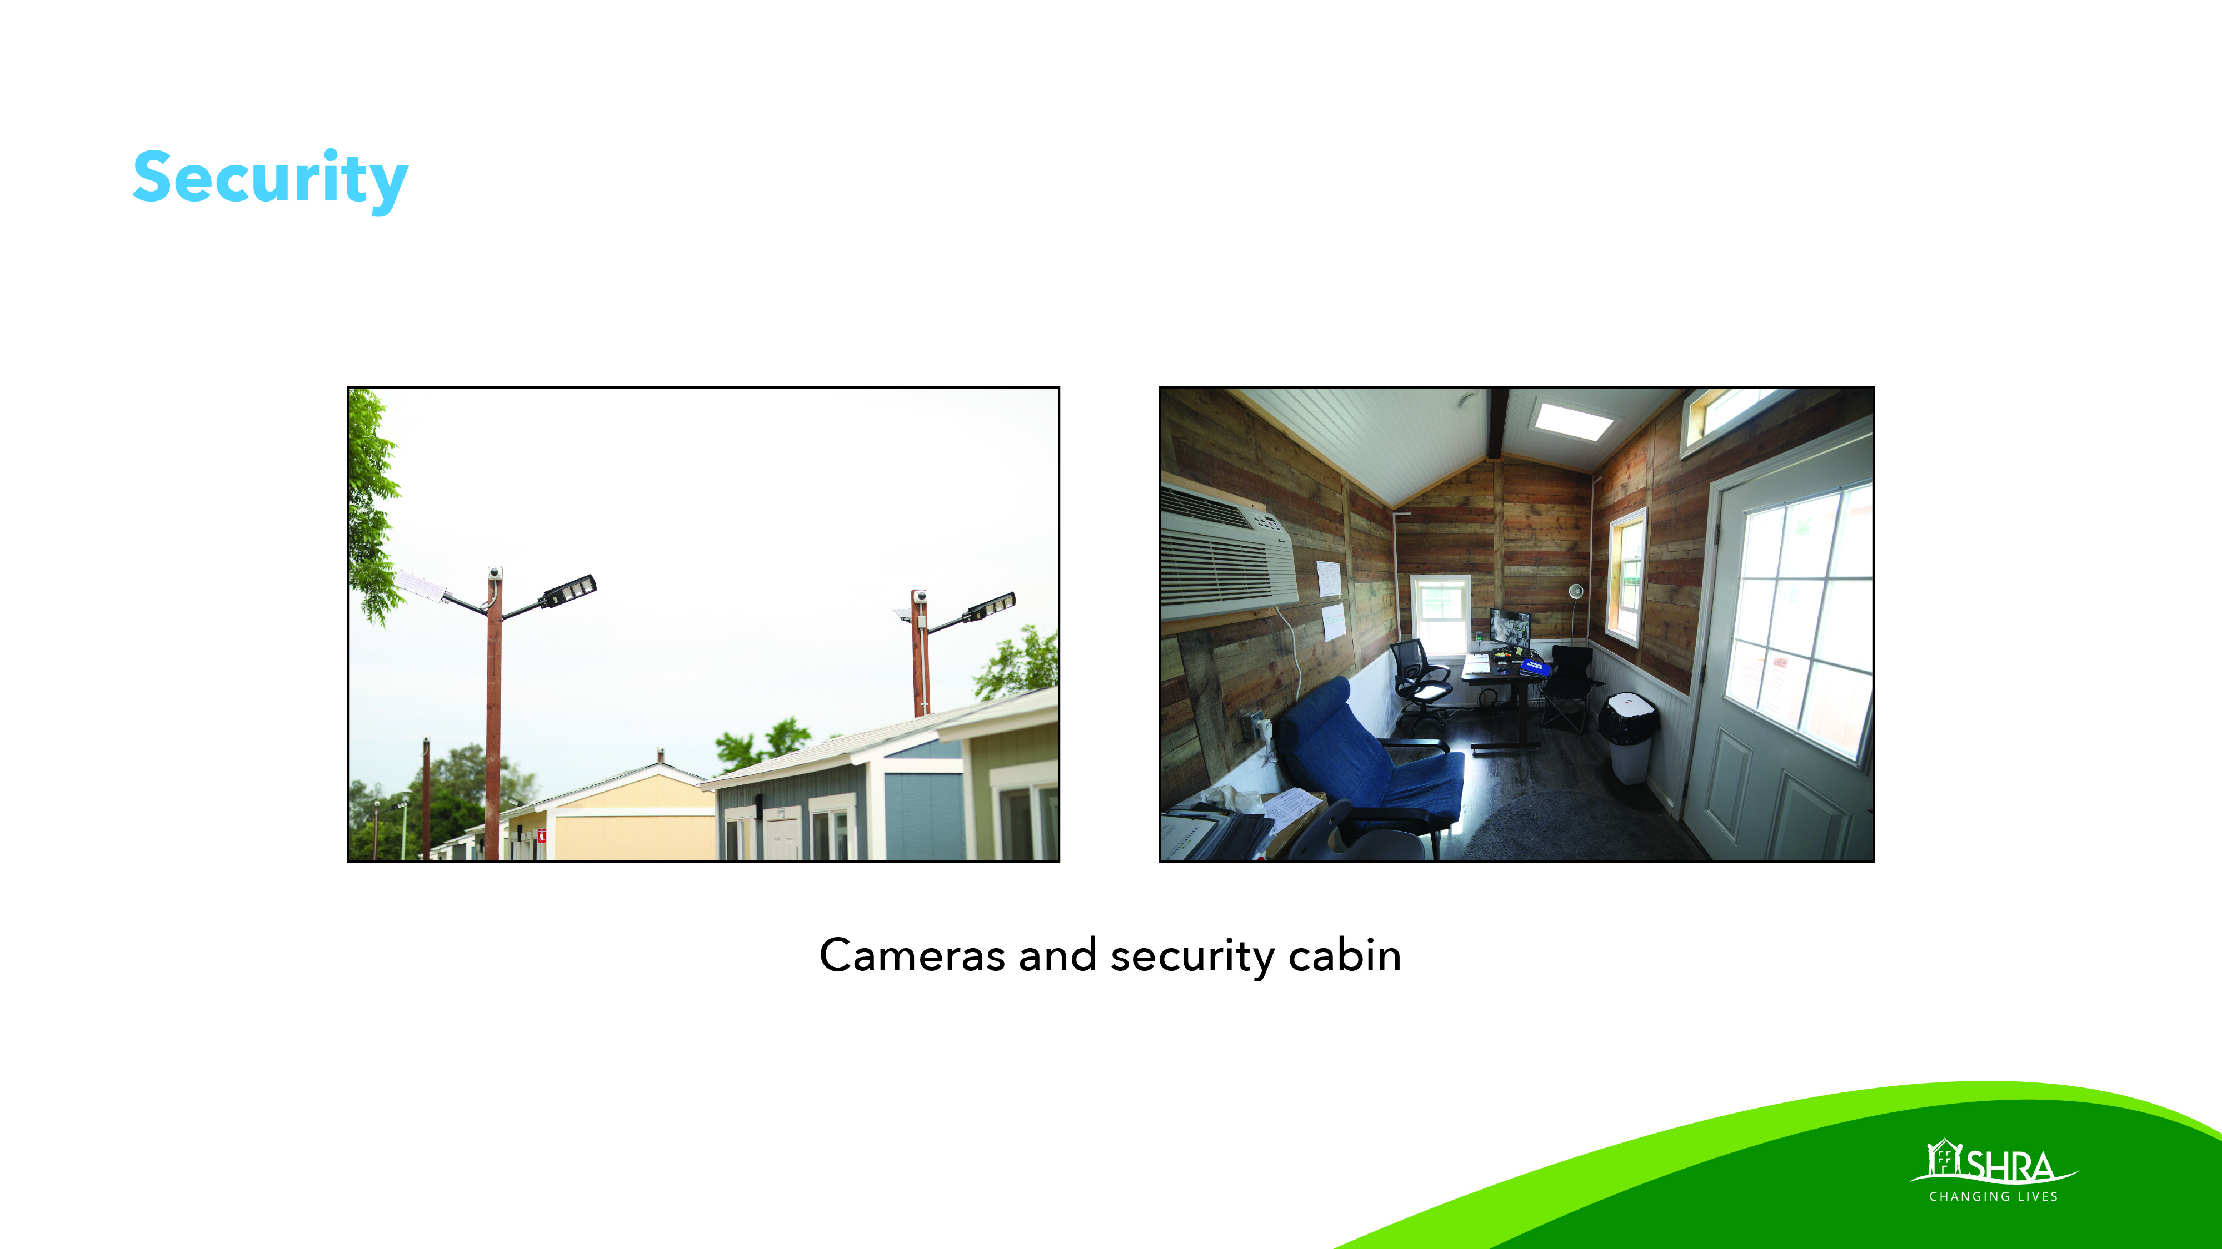

Slide 12

Notes:
https://urldefense.proofpoint.com/v2/url?u=https-3A__youtu.be_8gaU1RFIfbs&d=DwMFaQ&c=wdeQ6M4BRJsiprlaN2fQzA&r=wK4hMiEOullABN-T3KrIvbkk4LXVXKbEH6EMYbZB0d8&m=nmyHcv2ShJrSc4l8SJanXTneu9_Js5ZdiXOjgfZ8Hm4&s=inLHzSKB_hSMKC6UZezv24VMqzTfK4xGU1N-CcOj85E&e=

