Slide 1
Mirasol Village Park & Community Garden
November 6,2019

Slide 2
From Twin Rivers to Mirasol Village
$310M neighborhood transformation project.
500 new energy efficient housing units – 80% affordable.
Over 800 Carbon sequestering shade trees will be planted.
Mixed income housing; multi-modal transit opportunities include new light rail station adjacent to development.
All electric car-share fleet, parked on state-of-art Storm Water management system.
Bike lanes, bike share, bus shelters, & transit passes.

Slide 3
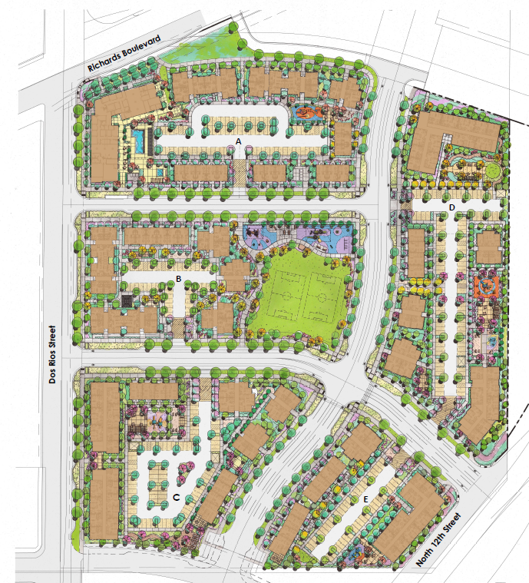
Mirasol Village Site Plan

Slide 5
Mirasol Village Park
A new 1.1 acre multi-benefit public park
Designed with green infrastructure elements
Will serve a severely disadvantaged community in the River District neighborhood
Will be for public use and entirely accessible, including ADA compliant sidewalks at perimeter of the park
Site will be open on 3 sides with unfenced perimeter; fencing at play areas

Slide 6
ChamberMaxx® System

Slide 7
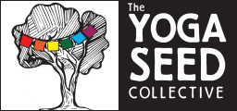
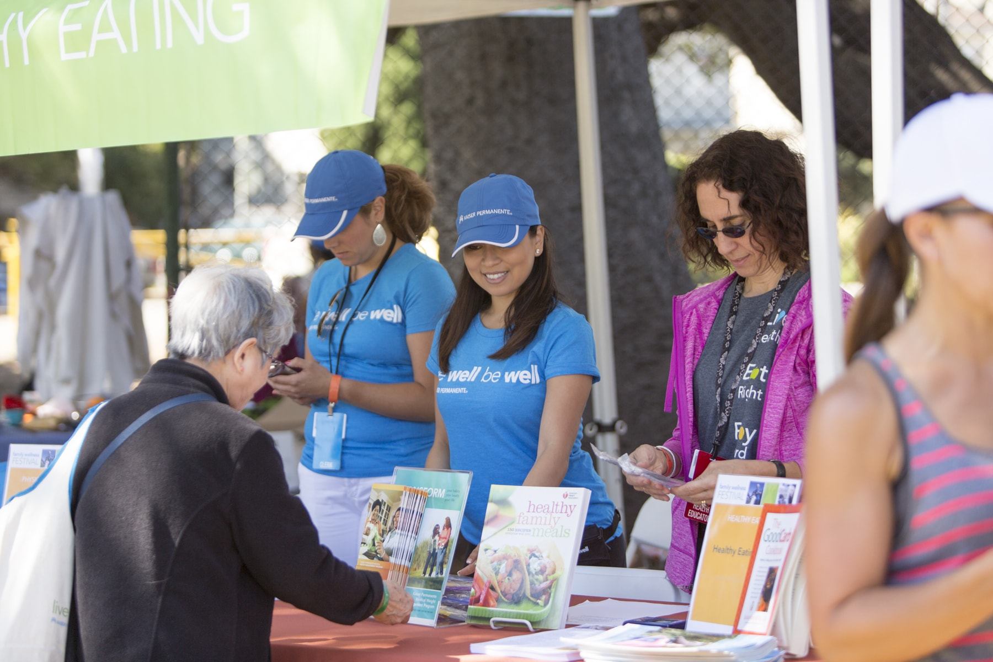
Resident Programs at Mirasol Village

Slide 8
Mirasol Village Park Funding
SHRA is a finalist for a $1.8 million grant from the CA Natural Resources Agency & is awaiting an invitation to the Final Phase of the grant selection process
The grant supports green infrastructure (e.g., bioswales, stormwater detention basins) and community parks
There is no funding match required for this grant
Grants announced in April 2020

Slide 9
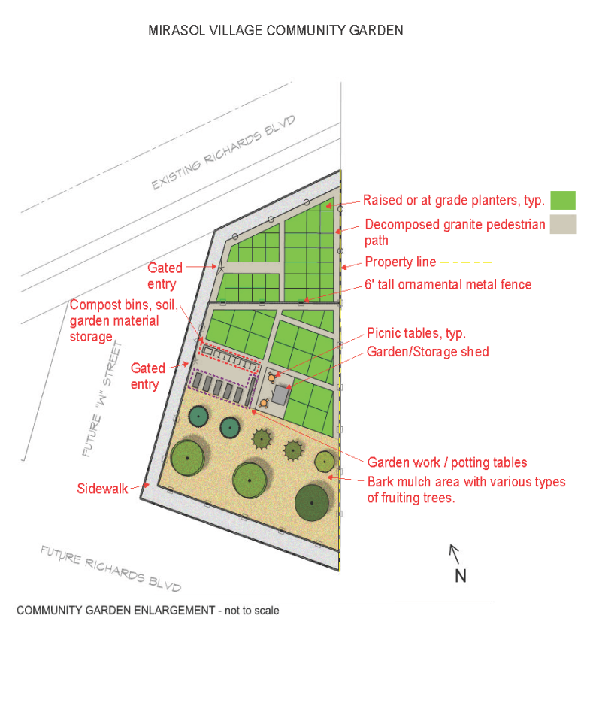
Mirasol Village Community Garden
Alchemist Community Development Corporation (CDC) is a nonprofit organization that connects communities to land, food and opportunities.
Alchemist will implement the community garden project, including:
Urban agriculture education,
cooking classes,
youth events and
a harvest festival.
Interpretive panels in the park will connect the role of pollinators to the success of the garden.

Slide 10
Timeline
November 2019 – Park Master Plan and Construction Agreement approved by City Council
December 2019 – Authorizing Resolution approval
Spring 2020 – GI Grant Agreement; Complete underground systems; Complete Park construction drawings
Summer 2020 – Obtain Park construction permits; Solicit for bids
Late 2020 – Park construction Notice to Proceed
Fall 2021 – Project Completion

Slide 11
Thank You

